Slide 1
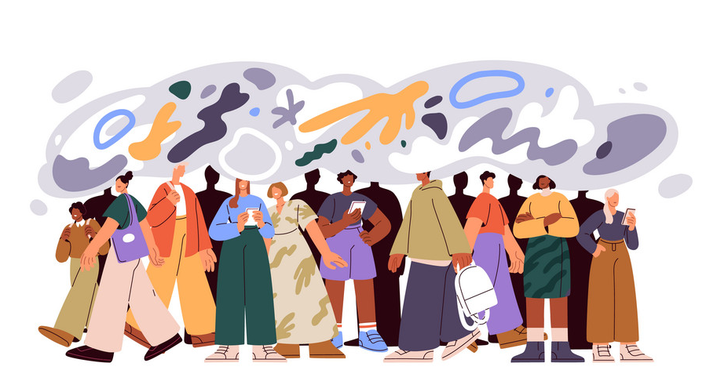
Social Psychology
Ms. Rabia Ijaz
Lecturer (Science & Humanities)

Slide 2
Learning Objectives
What is social psychology
Different concepts in social psychology
Brief history
Attitudes - Definition and nature
Social Loafing and Social Facilitation

Slide 3

Social Psychology
Social psychology is the scientific study of how people think, influence, and relate to one another.
According to psychologist Gordon Allport, social psychology uses scientific methods to understand and explain “How the thoughts, feelings, and behavior of individuals are influenced by the actual, imagined, or implied the presence of other human beings”.
Social psychologists focus on the situation. They study the social influences that explain why the same person acts differently in different situations.
For example, social psychologists study the effect of the home team advantage, the impact of racism and discrimination, the driving motivation in gangs, the explanations we give for our own and others’ behaviors, etc.

Slide 4
History of Social Psychology
Plato referred to the idea of the "crowd mind," and concepts such as “social loafing” and “social facilitation” which were introduced in the late 1800s.
Main questions after World War II
What could explain why people participated in such evil actions?
Were people following orders and bowing to social pressure, or were there some other forces at work?
Social psychologists are interested in the impact that the social environment and group interactions have on attitudes and behaviors.
The horrors of the Holocaust (destruction or slaughter on a mass scale, especially caused by fire or nuclear war) led researchers to study social influence, conformity, and obedience.

Slide 5
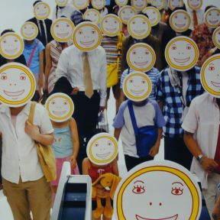
Crowd-mind
Emerges when formation of a crowd causes fusion of individual minds into one collective mind.
Members of the crowd lose their individuality.

Slide 6
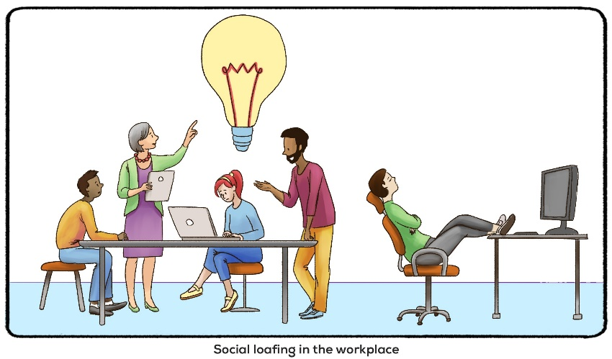
Social Loafing
Tendency for people in a group to exert less effort when pooling their efforts toward attaining a common goal than when individually accountable.
In group projects, social loafing often occurs, as individuals free ride on the efforts of others. an entertainer asking an audience to scream is also an example of social loafing because as you add more people to a group, the total group effort declines.

Slide 7
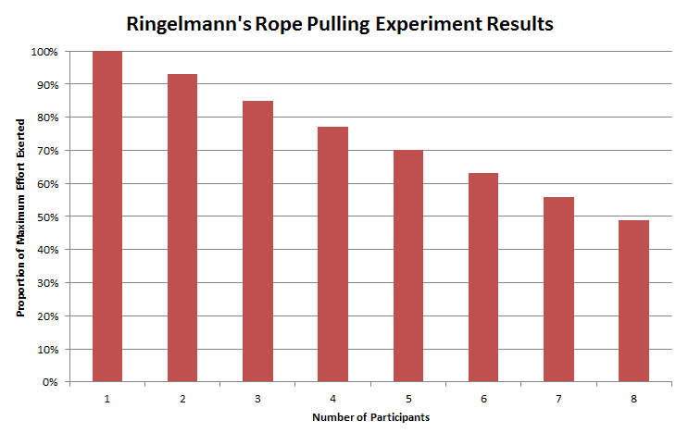
Tug of War is the perfect example because it's where Maximillian Ringelmann originally found it. He realized that as you add more people to a Tug of War game, the amount of pressure did not scale up perfectly. he noticed group pulling-power in a tug-of-war was less than the sum of individual strengths. In fact, the average contribution decreased each time he added members to the team.
This phenomenon suggests members put in less effort as group size grows.

Slide 8
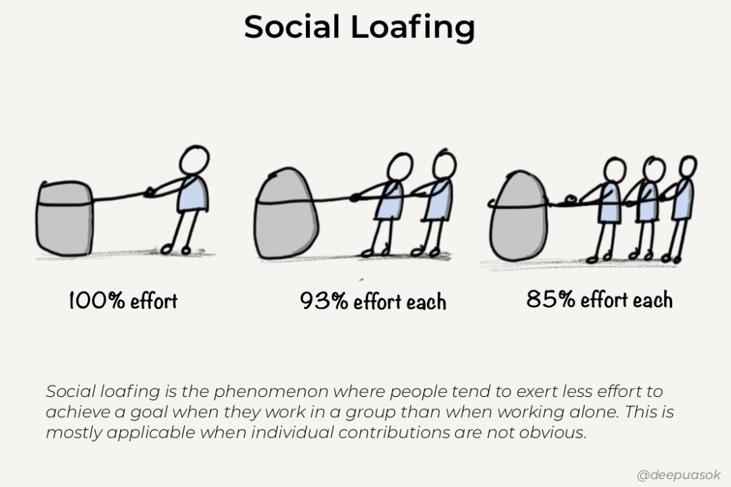

Slide 9

Social Facilitation vs. Social Loafing
Social loafing is actually the result of a phenomenon known as “social facilitation“.
Social facilitation is the idea that a person’s performance changes when they are around others versus when they are alone. OR , the tendency to perform better when in the presence of others
Often, performance increases; however, when groups become larger and larger, performance may decrease (social loafing.)
Example: Crowd encourage a team playing well.

Slide 10
factors influencing social facilitation
If a task is difficult or complex, social facilitation is less likely to occur. Instead, impairment in task performance might happen.
People who are more confident or look more favorably on social situations may see their performance enhanced compared to those who view them negatively or who have low self-esteem.
Factors such as the supportiveness of the audience and it's size may play a role in social facilitation.

Slide 11
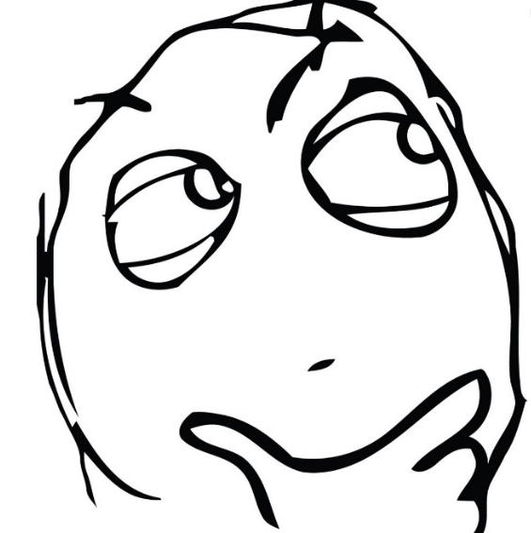
What do you think …..
of death penalty?
which political party does a better job of running the country?
if prayer be allowed in schools?
Whether violence on television be regulated?

Slide 12
Attitudes
In psychology, an attitude refers to a set of emotions, beliefs, and behaviors toward a particular object, person, thing, or event.
Attitudes are often the result of experience or upbringing. They can have a powerful influence over behavior and affect how people act in various situations.
Evaluations of a particular person, behavior, belief, or concept, or “a tendency to respond positively or negatively toward a certain idea, person, object, or situation” (Triandis, 1971).
While attitudes are enduring, they can also change.

Slide 13
Attitudes are learned tendency to evaluate things in a certain way. Evaluations may be of people, issues, objects, or events.
Such evaluations are often positive or negative, but they can also be uncertain at times. An attitude involves making a decision or an evaluation concerning liking vs. disliking, approving vs. disapproving or favoring vs. disfavoring a particular issue, object or person.
Different peoples can have different attitude towards a same things or ideas.
Why Study Attitudes?
Strongly influence our thought - help to organize and evaluate situations (positive or negative)
Sometimes they have a strong affect on behavior -help to predict people’s behavior in wide range of contexts (e.g., relationships, voting)

Slide 14
Affective component
How the object, person, issue, or event makes you feel
Behavioral component
How attitude influences your behavior
Cognitive component
Our thoughts and beliefs about the subject
ABC Model of Attitude
Components of Attitude
Psychologists such as Rosenber, Eagley and Hovland have given a three component model of attitude. According to this model, an attitude has following three components:

Slide 15
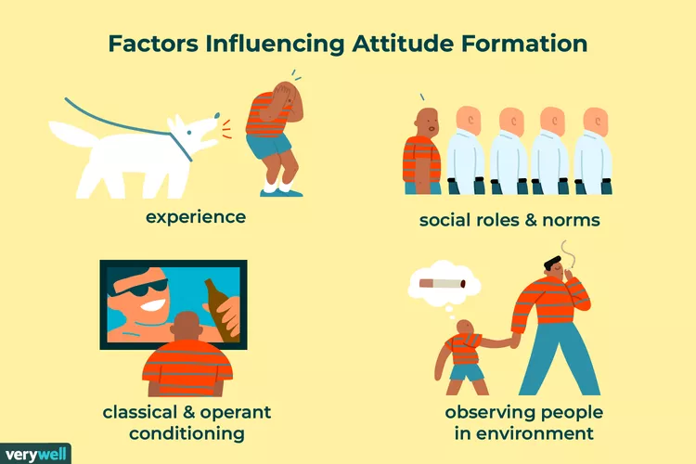
How our attitudes are formed?

Slide 16
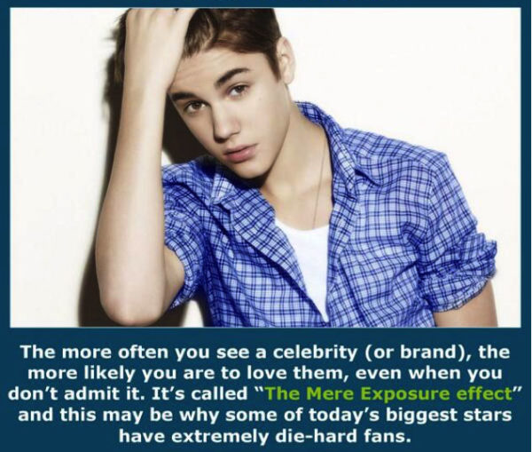
Mere Exposure
In 1968, Social Psychologist Robert Zajonc’s hypothesized that simply being exposed to something on a repeated basis was enough to make people like that thing.
The tendency to develop more positive feelings toward objects and individuals the more we are exposed to them.
“A psychological phenomenon by which people tend to develop a preference for things or people that are more familiar to them than others. Repeated exposure increases familiarity. This effect is therefore also known as the familiarity principle.”
the phenomenon that repeated exposure to novel stimuli increases liking of them

Slide 17
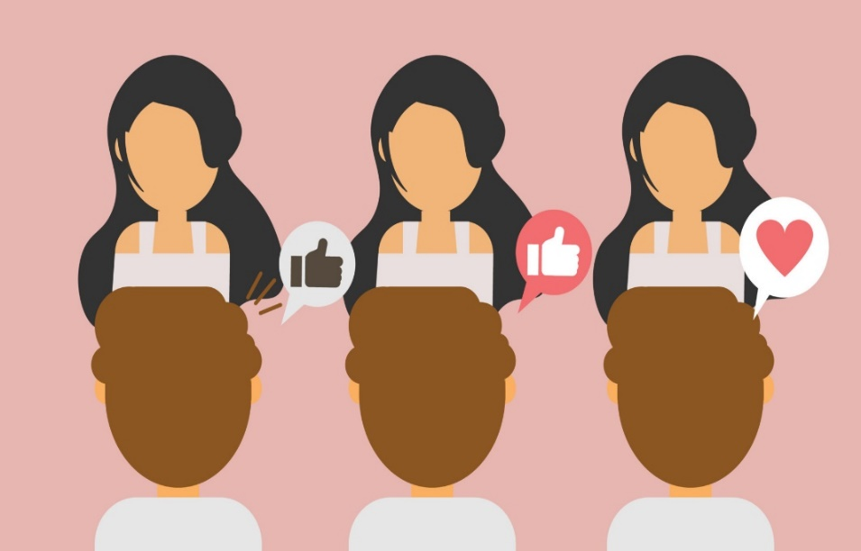
He experimented by showing participants various representations such as foreign words, faces of strangers and Chinese characters.
Some of the participants had seen these once before, others many times, while some were viewing them for the first time. After they were presented, Zajonc asked them to rate the images' levels of pleasantness.
Findings of the study:
Across the board, those who had seen the images previously liked it the most.
Participants favored the particular stimulus that they are more exposed to.

Slide 18
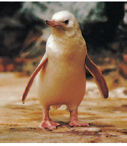
How does familiarity lead to acceptance?
When this rare white penguin was born in the Sydney, Australia zoo, his tuxedoed peers ostracized him. Zookeepers thought they would need to dye him black to gain acceptance.
But after three weeks of contact (mere exposure), the other penguins came to accept him.
For our ancestors, this mere exposure effect likely had survival value. What was familiar was generally safe and approachable. What was unfamiliar was more often dangerous and threatening.
Evolution may therefore have hard-wired into us the tendency to bond with those who are familiar and to be wary of those whose looks are unfamiliar. (Sofer et al., 2015; Zajonc, 1998)

Slide 19
Example:
The mere exposure effect explains why seeing the same advertisement multiple times could be more convincing than just seeing it once: that “as seen on TV” product may seem silly the first time you hear about it, but after seeing the ad a few more times, you start to think about buying the product yourself.

Slide 20
How attitudes change?

Slide 21
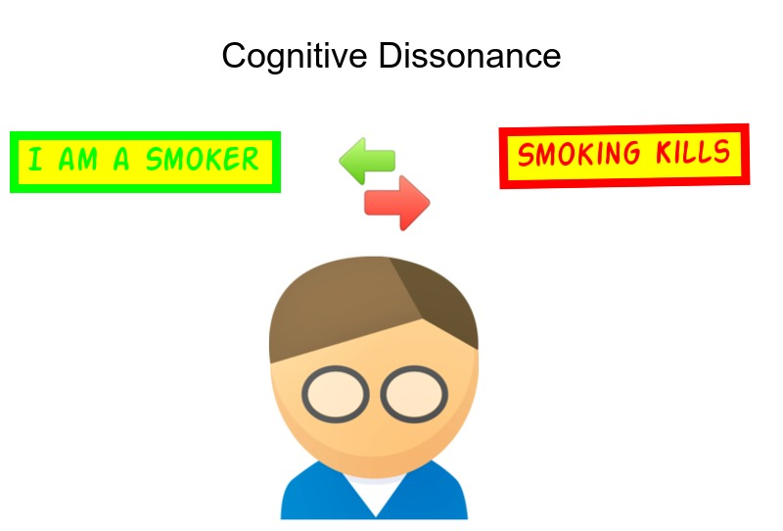
Cognitive Dissonance Theory (Festinger, 1957)
Cognitive-thought
Dissonance-conflict
“The mental conﬂict that take place when a person holds two contradictory (opposite) attitudes or thoughts and feels emotional discomfort”.
Cognitive dissonance is attitude change via an Internal discrepancy.
To reduce the dissonance, either the person
1.Gives up the smoking
2.Give excuses about smoking

Slide 22
Leon Festinger’s theory that we act to reduce the discomfort (dissonance) we feel when two of our thoughts (cognitions) or our thoughts and behaviors are inconsistent
For example, when we become aware that our attitudes and our actions clash, we can reduce the resulting dissonance by changing our attitudes.
For instance, a person who smokes and enjoys the sensation, may also know that smoking cigarettes is correlated with lung cancer.
This disconnect between a belief (smoking causes cancer) and a behavior (continuing to smoke cigarettes) causes tension or dissonance.
To relieve the dissonance, a person must either change the behavior (stop smoking) or change the thought (“I may die young, but at least I am enjoying myself today!”)

Slide 23

Persuasion is any deliberate attempt to change attitudes or beliefs through information and arguments
A symbolic process in which communicators try to convince other people to change their attitudes or behaviors regarding an issue
Persuasion is attitude change via an external message
For example: Good salespeople use persuasion to get people to buy things.

Slide 24
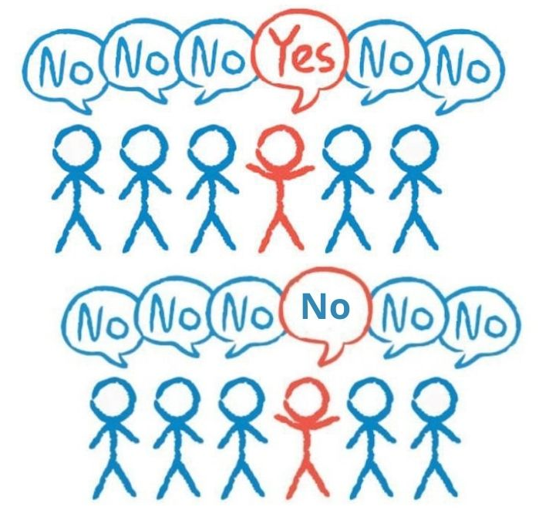
Conformity
A type of social influence involving a change in a belief/ attitude or behavior in order to fit in with a group.
Adjusting our behavior or thinking to coincide with a group standard because of real or imagined pressure to fit in. Following what others do.
For example: Someone does not know the answer to a question, so ends up saying what the rest of the crowd says due to lack of knowledge.

Slide 25
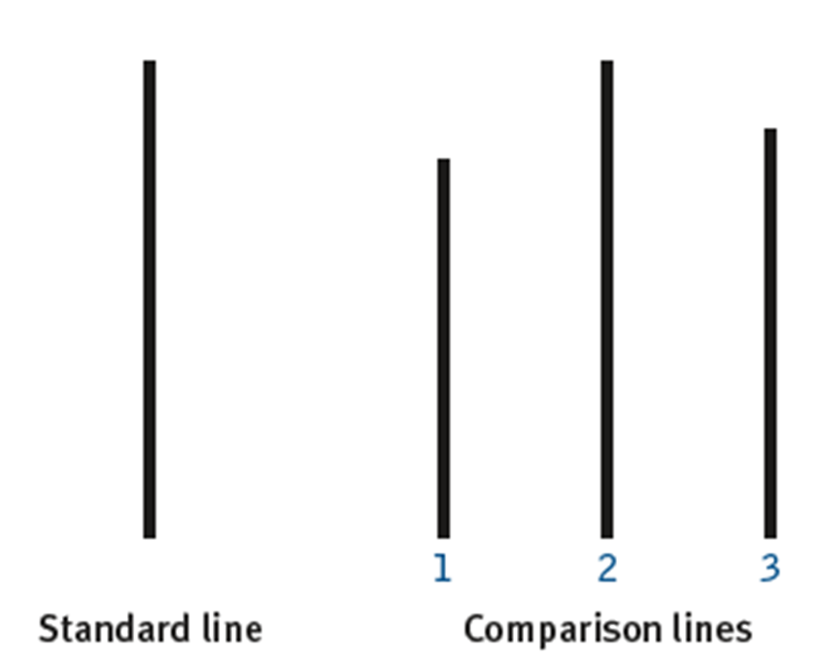
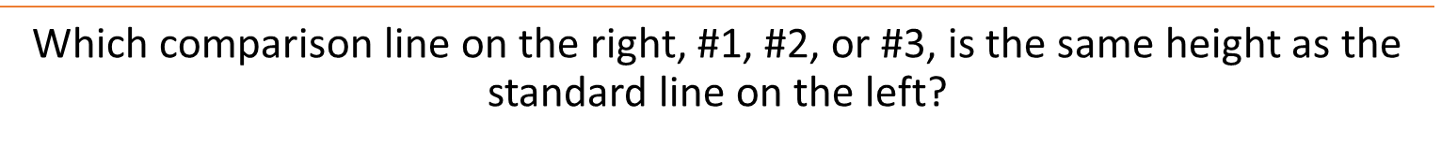

Slide 26
Types of Conformity
Normative Conformity
Yielding to group pressure just to fit in with the group.
Going along with the group so they will like you.
Informational Conformity
Going along with the group because you think they know more than you do.
Lack of knowledge leads someone to agree with the group

Slide 27
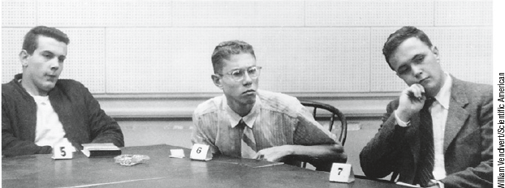
Solomon Asch’s Line Experiment
Involving 50 male students from Swarthmore College (USA) in a vision test. Students were tested on the length of a line relative to another line.
Participants had confederates around them who intentionally gave wrong answers to see if the participant would agree with them.
Conclusion
About 75% of participants conformed and 25% of participants never conformed.
These results suggest that conformity can be influenced both by a need to fit in and a belief that other people are smarter or better informed.
People will conform to the group answer even when it is clearly incorrect.

Slide 28
Why did the participants conform so readily?
When they were interviewed after the experiment, most of them said that they did not really believe their conforming answers, but had gone along with the group for fear of being ridiculed or thought “weird".
A few of them said that they really did believe the group's answers were correct.

Slide 29
compliance refers to situations in which one person bends to the requests of another person who has little or no authority. Compliance involves changing your behavior because someone asked you to do so. While you may have had the option to refuse the request, you chose to comply.
These requests can be direct or indirect
A student helping another student with their homework when asked
Wearing a mask and socially distancing during the COVID-19 pandemic

Slide 30
Techniques Used in Compliance
The "Door-in-the-Face" Technique: In this approach, marketers start by asking for a large commitment. When the other person refuses, they then make a smaller and more reasonable request.
The "Foot-in-the-Door" Technique: In this approach, marketers start by asking for and obtaining a small commitment. Once you have complied with the first request, you are more likely to also comply with a second, larger request

Slide 31
Obedience
A change in behavior in response to the commands of others.
Obedience as a form of social influence elicited in response to direct orders from an authority figure
Examples: A child who cleans his or her room when told to do so by a parent
A soldier who follows the orders of a superior officer.

Slide 32
Prejudice
Prejudice is a negative attitude and feeling toward an individual based solely on one’s membership in a particular social group.
Prejudice is common against people who are members of an unfamiliar cultural group.
An example of prejudice is having a negative attitude toward people who are not born in the United States.

Slide 33

A stereotype is a specific belief or assumption (thoughts) about individuals based solely on their membership in a group, regardless of their individual characteristics.
Stereotypes can be positive or negative and when overgeneralized are applied to all members of a group.
These beliefs are overgeneralized to all members of the group

Slide 34

When someone acts on prejudiced attitudes toward a group of people this is known as discrimination. Discrimination is negative action toward an individual as a result of one’s membership in a particular group

Slide 35
Negative Emotions
Holding emotions such as hostility or fear.
Stereotypes
Generalized beliefs about a group of people.
Predisposition to Discriminate
Acting in negative and unjustifiable ways toward members of the group.

Slide 36
How do we cognitively simplify the world?
Stereotyped beliefs are in part a by-product of how we cognitively simplify the world.
To help understand the world around us, we sometimes form categories.
Chemists categorize molecules as organic and inorganic.
A basketball coach categorizes offensive players as guards and post players.
Therapists categorize psychological disorders.
We all categorize people by gender, ethnicity, race, age, and many other characteristics.

Slide 37
Self-perception theory (Bem, 1965)
Self-perception theory says that, 'When people are unsure about their feelings and motivations, they will use their own behavior to infer what they feel.' (i.e., behaviors can cause attitudes)
Self-perception theory predicts that acting would lead to feeling.
Examples:
“This is my second sandwich; I guess I was hungrier than I thought,” or,
“I’ve been biting my nails all day; something must be bugging me.”

